Slide 1
Chapter 3. The Fundamentals: Algorithms, the Integers, and Matrices
Section 3
Complexity of Algorithms

Slide 2
Outline
Introduction
Time Complexity
Understanding the Complexity of Algorithms
*Overview of complexity

Slide 3
Complexity of Algorithms
Remark
  Algorithm
    Produce correct answer
    Be efficient
  Efficiency
    Execution time (time complexity)
    Memory (space complexity)
  Space complexity is related to data structures

Slide 4
Complexity of Algorithms
Remark.
  Computational complexity means the cost of a program's execution
    Running time, memory requirement, ...
  Doesn’t mean:
    The cost of creating the program
  In this context, programs with lower complexity may require more development time

Slide 5
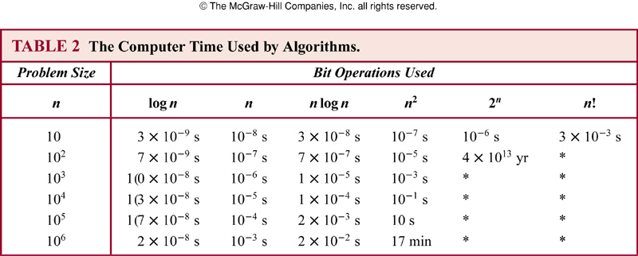
Time Complexity
Remark.
  Expressed in terms of number of operations when the input has a particular size
  Not in terms of actual execution time

Slide 6
Time Complexity
Remark.
  The operations can be comparison of integers, the addition of integers, the multiplication of integers, the division of integers, or any other basic operation
  Pay attention to worst-case analysis

Slide 7
Time Complexity
Different types of analysis
  Worst-case analysis
    Maximum number of operations
    Is a guarantee over all inputs of a given size
  Best-case analysis
    Minimum number of operations
    Not very practical
  Average-case analysis
    Average number of operations over all possible inputs of a given size
    Done with an assumed input probability distribution
    Can be complicated

Slide 8
Time Complexity
Example.
  Pseudocode of max algorithm
    procedure max(a₁, a₂, …, a_{n}: integers)
    max := a₁
    for i:=2 to n
    if max < a_{i} then max:=a_{i}
    {max is the largest element}
  There are 2(n-1)+1 = 2n-1 comparisons, the time complexity is Θ(n) measured in terms of the number of comparisons

Slide 9
Time Complexity
Example.
  Pseudocode of linear search algorithm
    procedure linear search(x:integer, a₁, a₂, …, a_{n}: distinct integers)
    i := 1
    while (I ≤ n and x ≠ a_{i})
    i:=i+1
    if i < n then location:=n
    else location:=0
    {location is the index of the term equal to x, or is 0 if x is not found}
  At most 2 comparisons per iteration, 2n+1 for the while loop and 1 more for if statement. At most 2n+2 comparisons are required, or O(n) comparisons

Slide 10
Time Complexity
Example.
  Pseudocode of binary search algorithm
    procedure binary search(x:integer, a₁, a₂, …, a_{n}: increasing integers)
    i:=1 (left endpoint of search interval)
    j:=n (right end point of search interval)
    while (i<j)
    begin
    m:=⎣(i+j)/2⎦
    if x>a_{m} then i:=m+1
    else j:=m
    end
    if x=a_{i} then location:=i
    else location:=0
    {location is the index of the term equal to x, or is 0 if x is not found}

Slide 11
Time Complexity
  Time Complexity of Binary Search
    For simplicity, assume n = 2^{k}, k = log₂n
    At each iteration, 2 comparisons are used
    For example, 2 comparisons are used when the list has 2^{k-1} elements, 2 comparisons are used when the list has 2^{k-2}, …, 2 comparisons are used when the list has 2¹ elements
    1 comparison is used when the list has 1 element, and 1 more comparison is used to determine this term is x
    Hence, at most 2k+2 = 2log₂n +2 comparisons are required

Slide 12
Time Complexity
  Time Complexity of Binary Search (continued)
    If n is not a power of 2, the list can be expanded to 2^{k+1}, and it requires at most 2 log₂n+2 comparisons
    The time complexity is at most Θ(logn)
    It follows that the binary search algorithm is more efficient, in the worst case, than a linear search

Slide 13
Time Complexity
Average Case Complexity
  Average-case analysis is usually more complicated than worst-case analysis
  For linear search, assume x is in the list
    If x is at 1st term, 3 comparisons are needed (1 to determine the end of list, 1 to compare x and 1st term, one outside the loop)
    If x is the 2nd term, 2 more comparisons are needed, so 5 comparisons are needed
    In general, if x is the i-th term, 2 comparisons are used at each of the i-th step of the loop, and 1 outside the loop, so 2i+1 comparisons are used
    On average,(3+5+7+…+2n+1)/n=(2(1+2+3+…n)+n)/n=n+2, which is Θ(n)

Slide 14
Time Complexity
Example.
  Pseudocode of bubble sort algorithm
    procedure bubble sort(a₁, a₂, …, a_{n}: real numbers with n≥2)
    for i:=1 to n-1
    for j:=1 to n-i
    if a_{j}>a_{j+1} then interchange a_{j} and a_{j+1}
    {a₁, a₂, …, a_{n} is in increasing order}
  When the i-th pass begins, the i-1 largest elements are guaranteed to be in the correct positions
  During this pass, n-i comparisons are used
  Thus from 2nd to (n-1)-th steps,
  (n-1)+(n-2)+…+2+1=(n-1)n/2 comparisons are used
  Time complexity is always Θ(n²), also the worst-case

Slide 15
Time Complexity
Example.
  Pseudocode of insertion sort algorithm
    procedure insertion sort(a₁, a₂, …, a_{n}: real numbers with n≥2)
    i:=1 (left endpoint of search interval)
    j:=n (right end point of search interval)
    for j:=2 to n
    begin
    i:=1
    while a_{j}>a_{i}
    i:=i+1
    m:=a_{j}
    for k:=0 to j-i-1
    a_{j-k}:= a_{j-k-1}
    a_{i}:= m
    end
    {a₁ , a₂, …, a_{n} are sorted}

Slide 16
Time Complexity
  Time complexity of Insertion Sort
    Insert j-th element into the correct position among the first j-1 elements that have already been put in correct order
    Use a linear search successively
    In the worst case, j comparisons are required to insert the j-th element, thus
    2+3+…+n=n(n+1)/2-1,
    and time complexity is Θ(n²)

Slide 17
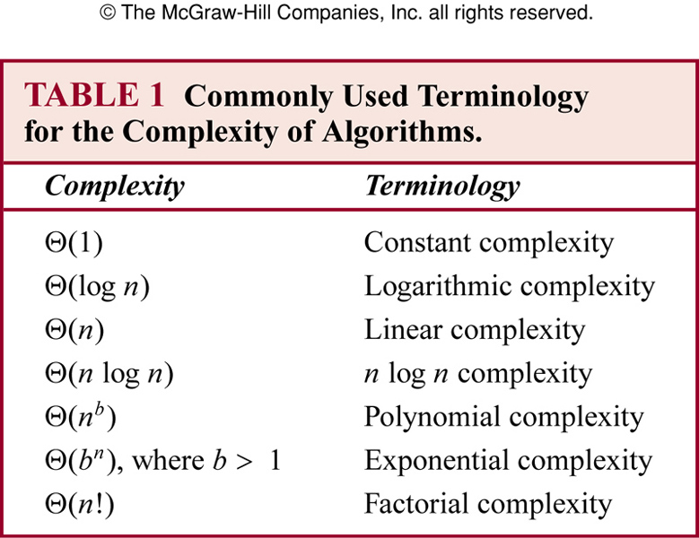
Understanding the Complexity of Algorithms

Slide 18
Understanding the Complexity of Algorithms
Complexity and Algorithms
  Logarithmic:
    Binary searching
  Linear:
    Linear searching
  Polynomial:
    Binary searching in the worst-case
  Exponential:
    Satisfiability of a proposition with n variables in Θ(2^{n})
  Factorial:
    Salesman travelling problem

Slide 19
Tractable Problems
Definition (易解性)
  A problem that is solvable by an algorithm with a polynomial worst-case complexity is called tractable (易解的)
  Often the degree and coefficients of the first term are small
  Otherwise also it may take an extremely long time to solve the problem
Intractable (难解的)
  An intractable problem is not tractable
  Intractable problems may have low average-case time complexity, or can be solved with approximate solutions

Slide 20
Solvable Problems
solvable (可解的)
  Some problems are solvable using an algorithm
    Many solvable problems are believed that no algorithm with polynomial worst-case time complexity solves them, but that a solution, if known, can be checked (or verified) in polynomial time
  e.g., satisfiability of a proposition
unsolvable (不可解的)
  Some problems are unsolvable
  e.g., the halting problem

Slide 21
NP Problems
Definition (NP问题)
  NP-class problems are such problems for which a solution can be checked in polynomial time
  “Check” means to verify whether the answer is true or false
  NP refers to nondeterministic polynomial time
  Deterministic algorithm: once given a particular input, it will always produce the same output, with the underlying machine always passing through the same sequence of states.
  Nondeterministic problem: can not solve by any deterministic algorithms

Slide 22
NP-Complete Problems
Definition (NP完全问题/NPC问题)
  NP-complete problems, NPC in short, are such problems that if any of these problems can be solved by a polynomial worst-case time algorithm, then all problems in the class NP can be solved by polynomial worst-cast time algorithms
  It is generally accepted, though not proven, that no NP-complete problem can be solved in polynomial time

Slide 23
NP-Complete Problems
Example.
  The Boolean satisfiability problem (SAT) is an NP-complete problem (Stephen Cook, 1971)
  E.g., E = (x₁∨¬x₂∨¬x₃)∧(x₁∨x₂∨x₄)
    We can quickly verify that an assignment of truth values to the variables of a compound proposition makes it true
    But no polynomial time algorithm has been discovered for finding such an assignment of truth values

Slide 24
Analysis of Algorithms
Complexity of Statements
  Simple statements (i.e., initialization of variables) have a complexity of O(1).
  Conditional statements (if … then … else … ) have a complexity of O(max(f(n),g(n))), where f(n) is upper bound on then part and g(n) is upper bound on else part
  Loops (while … do … )have a complexity of O(g(n)f(n)), where g(n) is an upper bound on the number of loop iterations and f(n) is an upper bound on the body of the loop.
    If g(n) and f(n) are constant, then this is constant time

Slide 25
Analysis of Algorithms
Complexity of Statements
  Repetitive halving or doubling (减半或加倍) of a loop counter results in logarithmic complexity.
      i ← 1
      while (i ≤ n)
      display i
      i = i * 2
      i ← 1
      while (i ≥ 1)
      display i
      i = i / 2
  Both of the above loops have O(log(n)) complexity.

Slide 26
**Overview of complexity
How can we show a problem is efficiently solvable?
  We can show it constructively. We provide an algorithm and show that it solves the problem efficiently.
  E.g.:
    Shortest path problem - Dijkstra’s algorithm runs in polynomial time, O(n²). Therefore the shortest path problem can be solved efficiently.
    Linear Programming – The Interior Point method has polynomial worst-case complexity. Therefore Linear programming can be solved efficiently.

Slide 27
**Overview of complexity
How can we show a problem is not efficiently solvable?
  How do you prove a negative? Much harder!
  This is the aim of complexity theory.

Slide 28
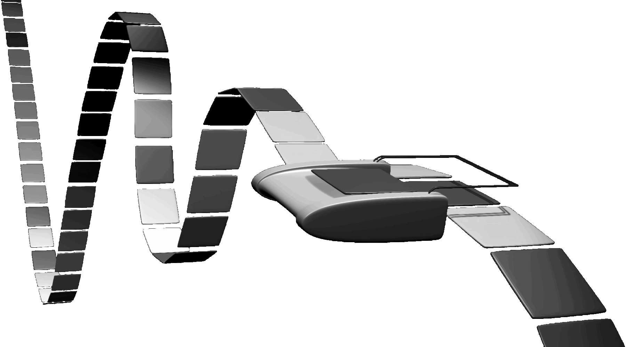
**Overview of complexity
Turing Machine
  In 1936, Alan Turing, a British mathematician, showed that there exists a relatively simple universal computing device , Turing Machine, that can perform any computational process
  Turing also showed the limits of computation – some problems cannot be computed even with the most powerful computer and even with unlimited amount of time
    e.g., Halting problem.
  Ref. http://en.wikipedia.org/wiki/Turing_machine

Slide 29
**Overview of complexity
Stored program concept
  John Von Neumann, brilliant mathematician, synthesizer, and promoter of the stored program concept, whose logical design of the Institute of Advanced Studies (Princeton) Computer became the prototype of today’s sequential computer
NP-Completeness
  Steven Cook Invented the theory of NP-Completeness - proved that a simple problem, Satisfiability, is NP-Complete
  Richard Karp Showed that several important problems and applications are NP-Complete and NP-hard, including Integer Programming (整数线性规划问题)

Slide 30
**Overview of complexity
Easy Problems
  we consider a problem X to be “easy” or efficiently solvable, if there is a polynomial time algorithm A for solving X. We denote by P the class of problems solvable in polynomial time.
Hard problems
  everything else. Any problem for which there is no polynomial time algorithm is an intractable problem.

Slide 31
**Overview of complexity
Class P
  Class of problems solvable in polynomial time.
  Example:
    Finding a word in a dictionary with n entries
      time ≈ log n (Polynomial time)
    Sorting n items
      time ≈ n log n (Polynomial time)
    Finding the shortest path from s to t
      time ≈ n² (Polynomial time)
    Finding the solution to a Linear Programming problem
      time ≈ n^{3.5} (Polynomial time)

Slide 32
**Overview of complexity
Class P
  Other examples of problems in the class P include:
    The assignment problem and transportation problem, finding the minimum cost flow problem and the max cost flow in in a directed graph.
  But we can not come up with an efficient algorithm for the longest path in a graph
    Input: A road map of cities with distances attached to the road map, and two designated cities A and B
    Output: A description of the longest path between A and B

Slide 33
**Overview of complexity
Decision problems (判定性问题)
  NP-Completeness theory deals with decision problems (判定性问题) - A problem for which there is a yes/no answer.
  Most optimization problems can be formulated as a decision problem
Examples:
  Given a propositional formula, is there an assignment of values True or False to its variables that makes the formula true?
  Is there a path between two nodes in a graph shorter than k? (decision version of shortest path problem)
  Is there a path between two nodes in a graph longer than k? (decision version of longest path problem)

Slide 34
**Overview of complexity
Class of NP
  Class of problems solvable in Nondeterministic Polynomial Time
  We say that a decision problem is solvable in Nondeterministic polynomial time if:
    The solution can be verified in polynomial time, more precisely, by a deterministic Turing machine.
    E.g., verifying that a path has length greater than K
  If we imagine that we have an exponential number of processors, we can check all possible solutions simultaneously and therefore answer in polynomial time

Slide 35
**Overview of complexity
Example
  Hamiltonian cycle is an NP problem, because it is easy to verify whether a closed chain go through all the vertices in the graph in O(n)
  It is hard to answer the question of “there is no Hamiltonian cycle in the graph”, because we can not try all the closed chains in polynomial time. This is a non NP problem

Slide 36
**Overview of complexity
Definition
  An equivalent formal definition: NP is the set of decision problems where the "yes"-instances can be recognized in polynomial time by a non-deterministic Turing machine.
    In fact an algorithm on such a non-deterministic machine consists of two phases: a guess about the solution which is generated in a non-deterministic way, and a deterministic algorithm which verifies or rejects the guess as a valid solution to the problem
Remark
  Any P problem is an NP problem

Slide 37
**Overview of complexity
NP-Complete
  The first problem to be shown to be NP-Complete was Satisfiability – Cook showed that all the problems in NP could be translated (in polynomial time) as Satisfiability problems
  The word complete means that every problem in the class NP-complete can be reduced (in polynomial time) into another problem of the class NP-complete. For example all the problems in the class NP-complete can be written as Satisfiability problems

Slide 38
**Overview of complexity
Remark
  The class of NP-Complete problems is the class of the hardest computational problems in the class NP: every NP problem can be transformed into an NP-complete problem (but the reverse is not true!)
NP
P
NP-Complete

Slide 39
**Overview of complexity
Remark
  Is P not equal to NP? A $1,000,000 question
    Is that true that not all problems in NP can be solved in polynomial time?
    http://www.claymath.org/Millennium_Prize_Problems/P_vs_NP/
Class of NP-Complete Problems
  They all admit exponential time solutions;
  Nobody has ever been able to find a polynomial time solution for any single problem in the class;
  Nobody has ever been able to prove an exponential lower bound for any single problem in the class

Slide 40
**Overview of complexity
Completeness
  – If someone were to find a polynomial time solution for a single problem in the class NP-complete, then all the problems could be solved in polynomial time!
  If someone were to prove an exponential lower bound for a single problem in the class NP-complete, then all the problems in the class would be intractable !

Slide 41
**Overview of complexity
Conjecture
  NP-Complete problems are inherently hard. They are intractable

Slide 42
**Overview of complexity
确定性问题
  有些计算问题的求解是确定性的，只要按照公式推导演绎，就可以得到结果。
    例：加减乘除运算
非确定性问题
  有些问题无法直接通过计算得到结果，其答案只能通过间接的“猜算”来得到。这类问题就是非确定性问题。
    例：大质数问题。目前无法推导出下一个质数是多少
    例：大合数分解质因数问题。目前没有一个确定的方法，从一个合数直接算出它的因子各自是多少

Slide 43
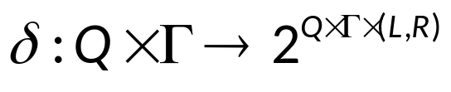
**Overview of complexity
确定型图灵机
  即通常所述的图灵机。
非确定型图灵机
  在计算的每一时刻，根据当前状态和读写头所读的符号，机器存在多种状态转移方案，机器将任意地选择其中一种方案继续运作，直到最后停机为止。
  状态转移函数
  非确定性图灵机包含的独立的元素是线性的，而包含的分支数则是指数型的。

Slide 44
**Overview of complexity
判定性问题
  是一类简单的问题，即只需要回答 yes 或者 no 的问题。
  任何一般的最优化问题都可以转化为一系列判定性问题，比如求图中从点 A 到点 B 的最短路径，可以转化成：从 A 到 B 是否有长度为1的路径？从 A 到 B 是否有长度为2的路径？……从 A 到 B 是否有长度为 k 的路径？如果问到了 k 的时候回答了yes，则停止发问，我们可以说从 A 到 B 的最短路径就是 k。

Slide 45
**Overview of complexity
P 类问题
  如果求解问题的计算复杂度是该问题的一个实例的规模 n的多项式函数（或称可以在多项式时间内求解），则称这类问题属于 P 类问题。P 类问题就是所有解的复杂度为多项式时间的问题的集合（这类问题也称为可由一个确定图灵机在多项式时间内解决）。

Slide 46
**Overview of complexity
NP 类问题
  有些问题很难找到多项式时间的求解算法（我们暂时不能断定它是否属于 P 类问题，比如找出无向图中的Hamilton 回路问题），但是我们发现如果给了我们该问题的一个答案，我们可以在多项式时间内判断这个答案是否正确（比如给定 n 阶无向图的一条回路，我们可以在 O(n) 内判断此回路是否是一条 Hamilton 回路）。这种可以在多项式时间内验证一个解是否正确的判定性问题称为 NP 问题（或称：多项式复杂程度的非确定性问题、多项式非确定性问题，由非确定性图灵机在多项式时间内解决）。
  所有的 P 类问题都是属于 NP 问题的。

Slide 47
**Overview of complexity
非NP类问题
  不能在多项式时间内判定一个解是否正确的问题（比如：判定一个图中不存在 Hamilton 回路）。
归约
  如果可以用问题 B 的解法解决问题 A，则称问题 A 可以归约为问题 B。此时 B 的时间复杂度高于或者等于 A 的时间复杂度（即问题 A 不比问题 B 难）。一个问题归约成另一个问题后，时间复杂度增加了，问题的应用范围也增大了。通过对某些问题的不断归约，我们能够不断寻找复杂度更高，但应用范围更广的算法来代替复杂度虽然低，但只能用于很小的一类问题的算法。
  通常情况下多项式时间内的归约才有意义。

Slide 48
**Overview of complexity
例：
  问题 A：求解一个一元一次方程；问题 B：求解一个一元二次方程。令问题 B 的一元二次方程的二次项系数为0，则问题 A 等价为问题 B。
例：
  问题 A：Hamilton 回路存在性；问题 B：TSP 问题。在Hamilton 回路问题中，两点相连即这两点距离为0，两点不直接相连则令其距离为1，于是问题 A 转化为在问题 B中，是否存在一条长为0的路径。Hamilton 回路存在当且仅当 TSP 问题中存在长为0的回路。此时，Hamilton 回路存在性问题归约成 TSP 问题。

Slide 49
**Overview of complexity
NPC 类问题
  如果存在这样一个 NP 类问题 S，所有的 NP 类问题都可以归约成它。换句话说，只要解决了这个问题，那么所有的 NP类问题都解决了。(Stephen A. Cook, 1971)
  这种 S 问题有很多个，它是一类问题，称为 NPC 类问题(Levin&Cook, 1972)，也就是 NP-完全问题（习惯陈述为 NPC 问题）。
  一个判定性问题 L 属于 NPC 类问题如果：
  1）L 属于 NP 类问题；
  2）任何一个 NP 类问题可以在多项式时间内归约为 L。
  一个判定性问题 L 属于 NP-hard 问题如果 L 只满足上述 2)

Slide 50
**Overview of complexity
NPC
  In computational complexity theory, the complexity class NP-complete (abbreviated NP-C or NPC) is a class of decision problems. A decision problem L is NP-complete if it is in the set of NP problems so that any given solution to the decision problem can be verified in polynomial time, and also in the set of NP-hard problems so that any NP problem can be converted into L by a transformation of the inputs in polynomial time.

Slide 51
**Overview of complexity
第一个 NPC 问题
  1971年 Stephen Cook 证明了Boolean satisfiability problem
  (SAT) 是一个NPC问题。SAT 指的是，给定一个包含 n 个布尔变量 X₁，X₂，…，X_{n} 的析取范式，是否存在它们的一个取值组合，使得该析取范式被满足?这个问题显然是 NP 的，因为对给定的一组逻辑变量值，很容易检查该范式是否为真。Cook 证明了这个问题是 NP-complete 的，即如果能解决上述问题，那就能解决所有的 NP 问题（并据此获得1982年图灵奖）。此后人们又陆续发现很多 NPC 问题，比如 Hamilton 回路问题。

Slide 52
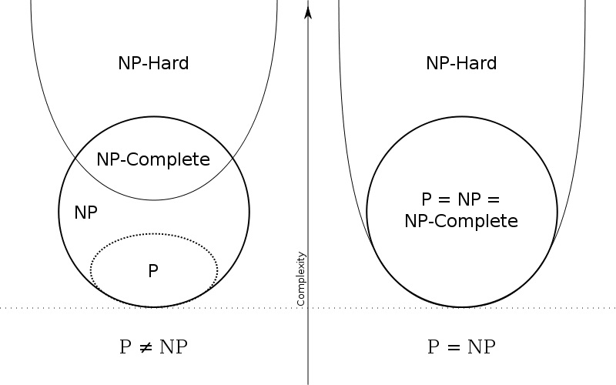
**Overview of complexity
NP 问题分类

Slide 53
**Overview of complexity
NP 问题
  简单写成 “NP=P？” 。即：NP 类问题到底是 Polynomial（多项式的），还是 Non-Polynomial？或者：P 类问题集合与 NP 类问题集合是否重合？
  既然所有的 NP 问题都能归约成 NPC 问题，那么只要任意一个 NPC 问题找到了一个多项式的算法，那么所有的 NP问题都能用这个算法解决，NP=P 成立。这是因为，每一个 NPC 问题可以在多项式时间内转化成任何一个 NP 问题
  NP 问题位居克莱数学研究所（Clay Mathematics Institute, CMI）的千禧年7大悬赏难题之首。

Slide 54
**Overview of complexity
Some NPC problems in Graph Theory：
  0-1 Integer linear programming
  Boolean satisfiability problem (SAT)
  Knapsack problem (Bounded Knapsack problem 背包问题)
  n-puzzle (数字推盘, 如重排九宫游戏的最优解 )
  Hamiltonian path problem
  Traveling saleman problem (TSP)
  Subgraph isomorphism problem
  Subset sum problem
  Clique problem
  Vertex cover problem
  Independent set problem
  Graph coloring problem
  Chinese postman problem

Slide 55
Assignment
Exercises after 3.3: No.5, 28(a)(b) (ver.6)
Exercises after 3.3: No.9, 40(a)(b) (ver.7)

